Slide 1
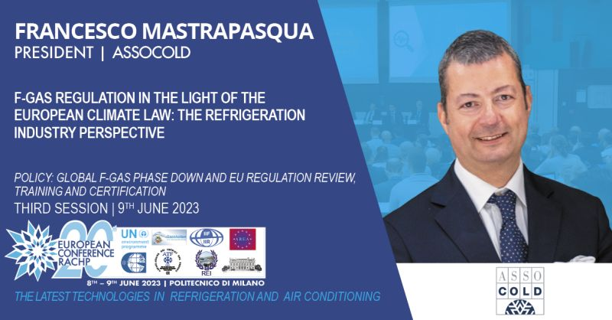

Slide 2
The F-Gas Regulation (EU) 517/2014
HFC demand decreased 39% in quantity and 49% in CO2eq from 2015 to 2021
GWP in imported appliances decreased 33%
62% less emissions in refrigeration
Better leakage rates and more refrigerants recovered
More refrigeration companies focused on natural refrigerants
European success story, the refrigeration sector moved to HFC-free alternatives, beyond the prescriptions of the Regulation

Slide 3
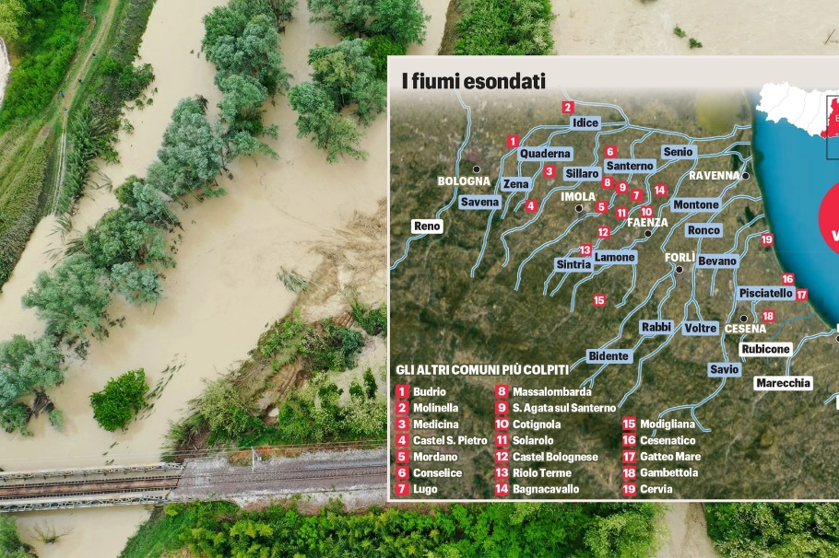
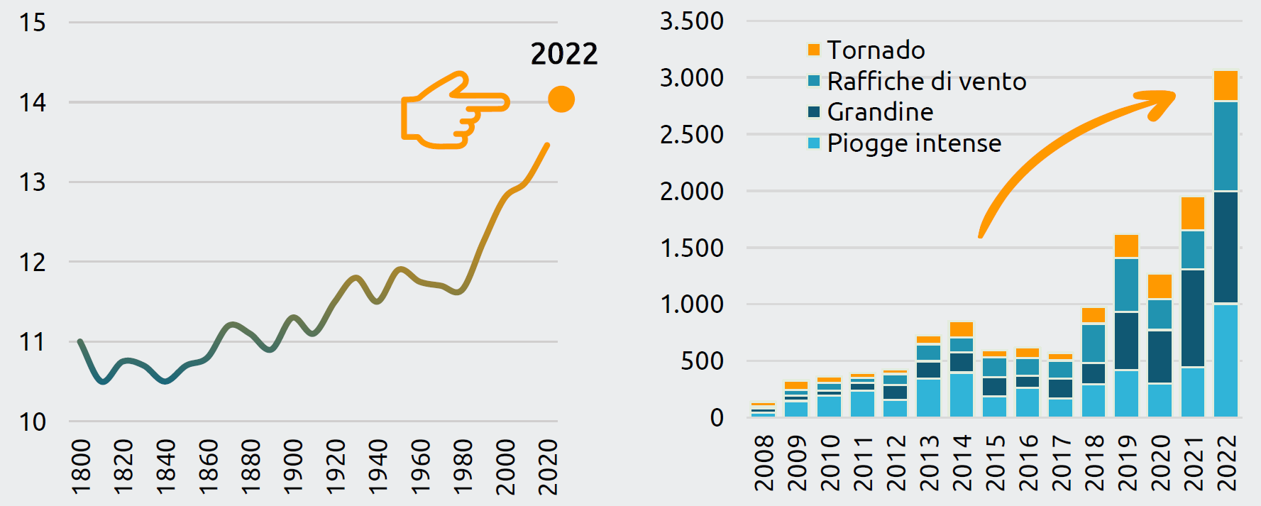
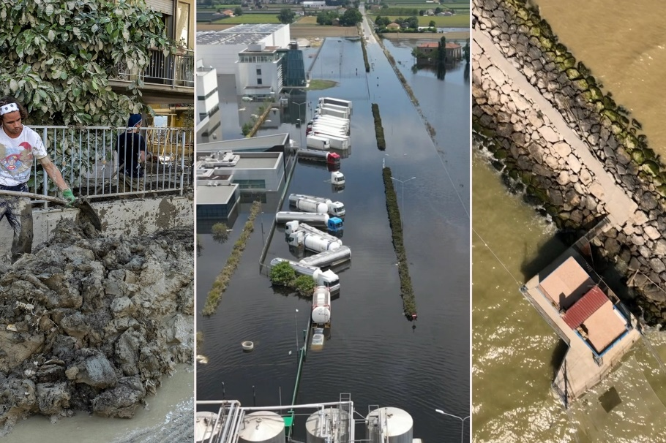
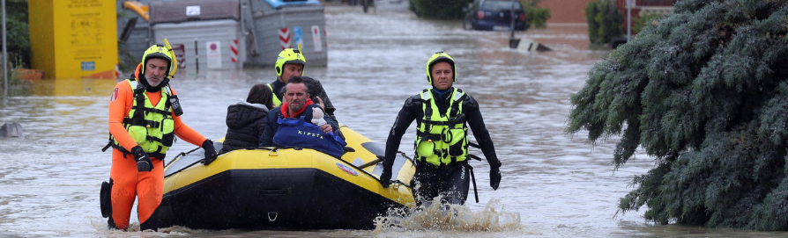

Living in a warmer world
Average annual temperature in Italy (°C) Number of extreme weather events in Italy
Tornado
Extreme winds
Hail
Heavy rains
Data provided by Italy for Climate, Cnr, Ispra, European SeverWeather Database

Slide 4
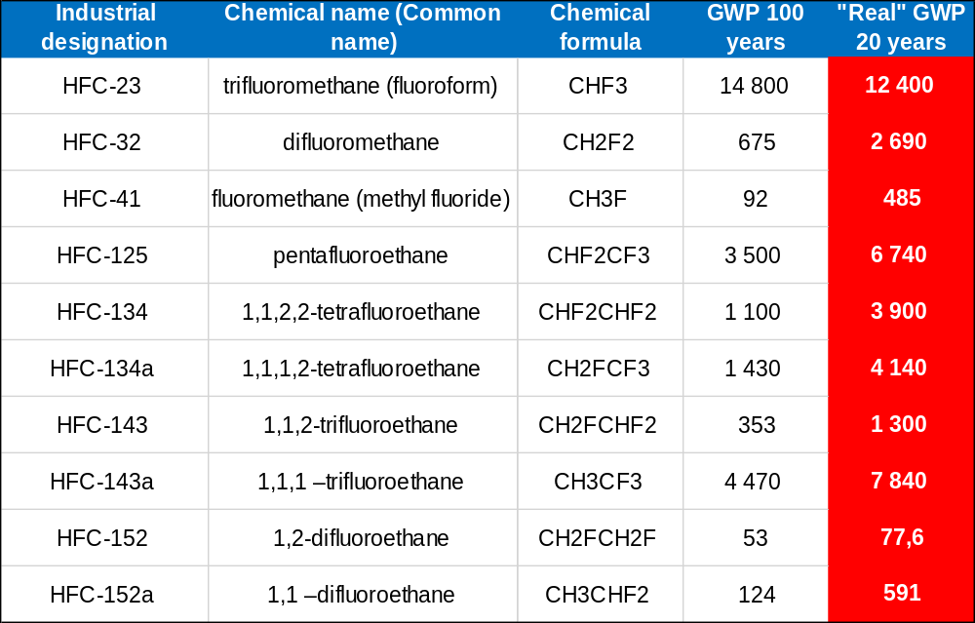
The real global warming effect of HFCs
Considering the relatively short lifetime of synthetic refrigerants in the atmosphere, the 20-year GWP much better reflects the true effect of these gases on climate.

Slide 5
Hydrocarbons, GWP 3
Flammable refrigerant used for self contained and/or hermetically sealed equipment in commercial, professional and household refrigeration and air conditioning according to the ISO/EN 60335 safety standards
5 million display cases and beverage coolers in EU
25 million household refrigerators and freezers per year sold in EU and 100-120 million/year sold globally using isobutane
R744 (CO2), GWP 1
Non-flammable refrigerant, used for centralized refrigeration systems, with power racks and/or condensing units, for medium and large stores and supermarkets in commercial and industrial refrigeration
60,000+ installations (stores) in Europe, with an annual growth rate of 40%
Ammonia, GWP 0
Mainly used for large distribution centers and for industrial refrigeration (pharma, food, process, etc.), increasingly using modest quantities of ammonia
2,450+ installations as of June 2021 in Europe, with an annual growth rate of 3-5%
Different natural refrigerants compete against each other in this sector, and in most cases for a given application there are several possible solutions using natural refrigerants
Data provided by Athmosphere, Shecco, 2022

Slide 6
The key advantages of natural refrigerants
Near-to-zero GWP and HFC quota free
Beneficial for the world environmental targets
Free from any potential chemical risk for the environment
The cost is low and stable compared to chemical refrigerants (especially if patented)
Pure fluids, free from any glide effect, hence highly performant and efficient
Compliant with any future environmental regulation
The current F-Gas has effectively contributed to shift the refrigeration sector to the NR based technologies

Slide 7
The ambition of the new F-Gas Regulation
Steep quota phase down
Discourage the use of F-gases with high GWP and encourage the use of alternative substances
Fight against illegal trade of HFCs
Prevent additional F-Gas emissions
Ensure compliance with the Montreal Protocol
Increase training and certification requirements
Improve monitoring and reporting
Strengthen the ambition in stationary refrigeration to free up quota for the harder to move sectors.
Align the industry on sustainable long-term solutions by replacing the proposed limits with the market-ready technologies.

Slide 8
The proposed F-gas quota phase down from 2024
54.6
Black | Parliament position
Blue | Commission proposal
Green | Council position
42.9
42.2
41.7
37
CRITICAL PHASE DOWN
21,7
20.9
Commission
Proposal
17.7
Council position
9.1
Parliament position
4.2
0

Slide 9
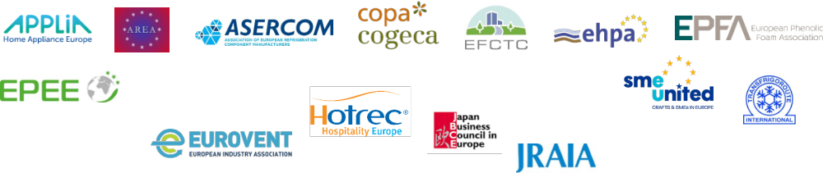
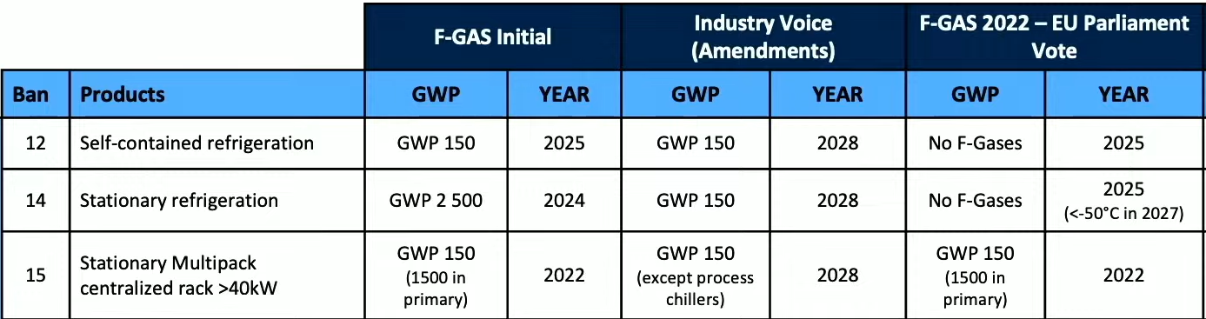
EU Parliament proposes service ban GWP<150 from 2030 for stationary refrigeration equipment (process chillers excluded)

Slide 10
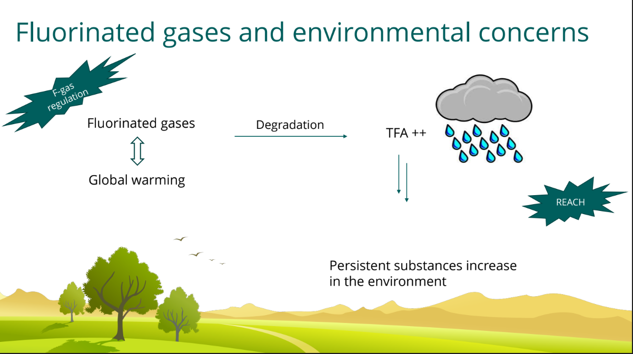
New restrictions for PFAS substances
The risks for human health and the environment from the rapidly increasing use PFAS substances are linked to pollution of the environment, including drinking water
PFASs are also called “forever chemicals”, as they are persistent themselves or degrade to other persistent PFASs, remaining in the environment for decades to centuries

Slide 11
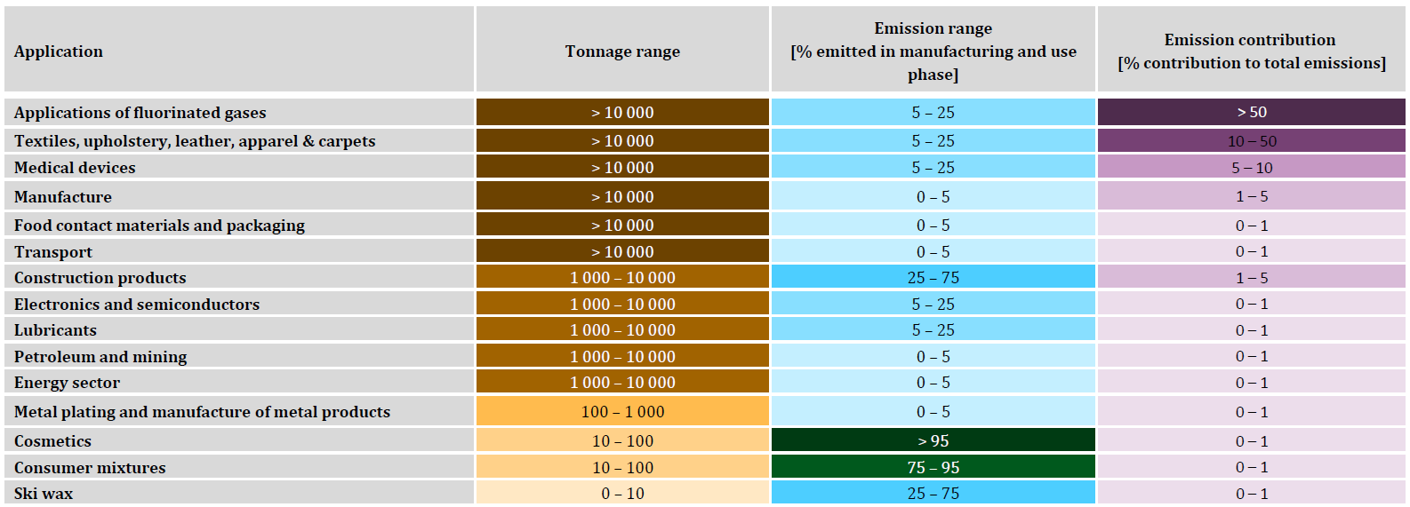
Proposal to the ECHA to restrict PFASs
The refrigerants defined as PFASs includes R-125, R-134a, R-143a, R-1234yf, R-1234ze(E), R-1336mzz(E), R-1336mzz(Z), R-1224yd and R-1233zd(E), and all the blends that contain them
The alternatives are natural refrigerants, R-32 and R-152a
PFAS substances currently have a number of other uses in the industry

Slide 12
Concluding remarks
F-Gases will be more restricted by the european regulations in the future due to their environmental impacts
We need to use natural refrigerants wherever possible, but not all the sectors are ready, some will require more time
Critical is the maintenance of existing equipment and systems that are generating continuing emissions
Professional training will be key in the environmental transition
The new regulations must be very ambitious but also realistic

